Slide 1
Data Structure and Algorithm
COURSE CODE: CS-201
TOPIC: REVISION OF STRUCTURES & POINTERS
COURSE INSTRUCTOR: HABIBA ARSHAD

Slide 2
Goals for today
To introduce :
  Structures
  Pointers
  Dynamic Memory allocation

Slide 3
Structures
As array is the collection of same type of elements but it may be possible to take a different type of elements together. It is useful to group different types of data which has some meaningful information.
If we want to create a record of any person which contains the name, age and address of that person then we make the structure of the record.

Slide 4
Structures
A structure is a collection of simple variables.
The variables in a structure can be of different types: Some can be int, some can be float, and so on.
The data items in a structure are called the members of the structure.

Slide 5
Defining a Structure
The structure definition tells the compiler about the detail of the structure and how the structure is organized
  It specifies what members the structure will have.
A structure is declared using the keyword struct.
It does not set aside any space in memory or even name any variables.
  This is unlike the definition of a simple variable, which does set aside memory.
The structure declaration is also called structure specifier.

Slide 6
Defining a Structure
The structure definition tells how the structure is organized: It specifies what members the structure will have.
Syntax:
  struct structure_name
  {
  DataType Identifier_a;
  DataType Identifier_b;
  DataType Identifier_c;
  };

Slide 7
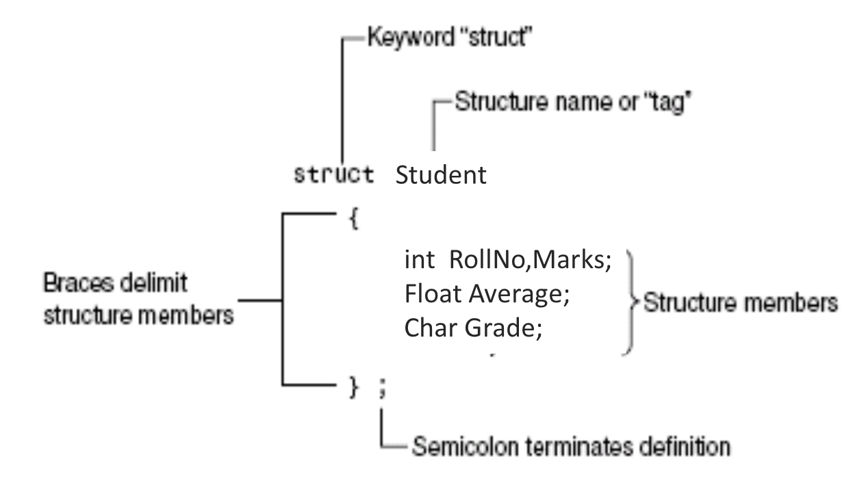
Defining a Structures
The above structure contains four member variables.
A new data type student is created in the above declaration.
A variable of type student can store four variables at one time.

Slide 8
Declaring a Structure Variable
The structure variable can be declared after the defining a structure.
The process of declaring a structure variable is same as delaring a variable of basic types such as int and char.
The declaration tells the compiler to allocate memory space for the variable.
The compiler automatically allocates sufficient memory according to the elements of the structure.
The structure can be defined inside or outside the main() function
If the structure is defined outside main() it’s variable can be declared inside or outside the main()
If the structure is defined inside main() it’s variable can only be declared inside the main()

Slide 9
Declaring a Structure Variable
RollNo (4 bytes)
Marks (4 bytes)
Average (4 bytes)
Grade (1 bytes)
Syntax
Struct_Name Identifier;
Example
struct Student
{
int RollNo, Marks;
float Average;
char Grade;
};
Student Usman;
Usman
(13 bytes)

Slide 10
Accessing Structure Members
Once a structure variable has been defined, its members can be accessed using something called the dot operator.
The structure member is written in three parts:
the name of the structure variable on the left side of the dot
The dot operator
and the member variable name on the right side of the dot
The dot operator is also called member access operator
Syntax
Struct_Var . Member_Variable;

Slide 11
Accessing Structure Members
Student Usman;
Usman.RollNo = 10;
Usman.Marks = 864;
Usman.Average = 89.52;
Usman.Grade = ‘A’;

Slide 12
Array Type Member of Structure
Members of the structure can be of different types
Can be simple variable, or array variables
Example
struct Student
{
int RollNo;
char Name[16];
int Marks[4];
};
Student s = { 10 , “Usman” , {35, 45, 25, 22}};

Slide 13
Pointers
A pointer is a variable which holds the address of other variable of the specified data type(like int,float,char).
In programming we basically use pointers to store the other variable’s address.
A pointer variable is declared with a ‘*’ before it.
It contains the memory address (locations) of another variable which is declared as the pointer type.

Slide 14
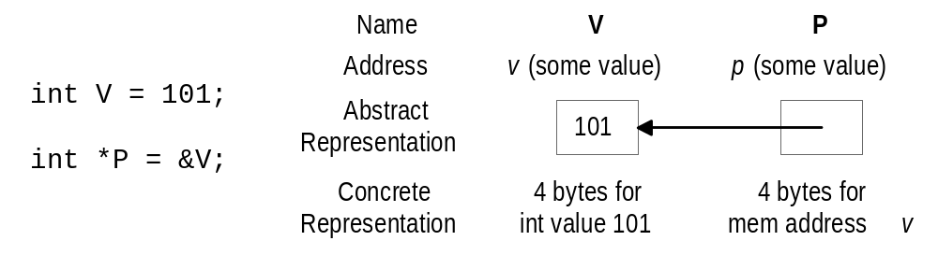
Pointer Basics
Variables are allocated at addresses in computer memory (address depends on computer/operating system)
Name of the variable is a reference to that memory address
A pointer variable contains a representation of an address of another variable (P is a pointer variable in the following):

Slide 15
Indirection (*) Operator
A pointer variable contains a memory address
To refer to the contents of the variable that the pointer points to, we use indirection operator
Syntax: *PointerVariable
Example:
  int V = 101;
  int *P = &V;
  /* Then *P would refer to the contents of the variable V (in this case, the integer 101) */

Slide 16
Pointer Variable Definition
Basic syntax: Type *Name
Examples:
  int *P; /* P is var that can point to an int var */
  float *Q; /* Q is a float pointer */
  char *R; /* R is a char pointer */
Complex example:
  int *AP[5]; /* AP is an array of 5 pointers to ints */

Slide 17
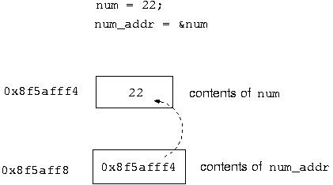
The & Operator
 The & is the address operator.
of the variable.
 Storing address in pointers
It
represents
the
address
int
int
num = 22;
*
num_addr
=
&num;

Slide 18
Point to be noted
int *a=&b is an easy way of assigning the address of ‘b’ to pointer ‘a’. This doesn’t mean *a is equal to ‘address of b’.
The size of the pointer variable varies according to the size of the computer architecture i.e. a 32-bit operating system takes 4 bytes while a 64-bit takes 8 bytes.
-> is the member access operator in case of pointers.

Slide 19
Memory Management with Pointers
The process of allocating and de-allocating memory is known as memory management.
Static Memory Allocation
Memory is allocated at compilation time
Dynamic Memory
Memory is allocated at running time

Slide 20
Static memory allocation
Memory to be allocated is specified while writing programs
      int i , j , k ;
      char name[ 20 ];
Class average example
      int main()
      {
      int n;
      cout << "Enter number of student" << endl;
      cin >> n;
      int age[n];
      }
Above approach has so many disadvantages

Slide 21
Dynamic memory allocation
In dynamic memory allocation, the heap is a special region of a computer’s memory used for storing data that is created (allocated) at runtime , that is, during the execution of a program, not when it is compiled.
Void Pointer A void pointer is a special type of pointer that can point to any data type — int, float, char,double, struct, etc. It is declared using the keyword void.
Declaration Syntax:
void *ptr;
This means ptr can hold the address of any data type — but you can’t directly dereference it (access the value) unless you typecast it first.
Type casting
    (int*) ptr; //*ptr without casting is error
Null pointer
Notes:
Type Casting: Conversion of one datatype to another
Heap is a type of data structures
Follows the rule of complete binary tree.

Slide 22
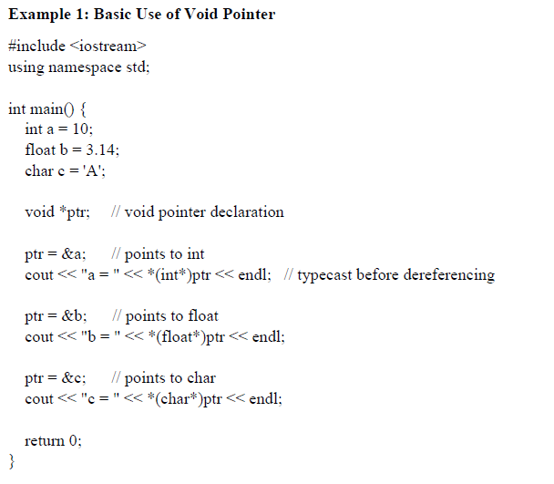


Slide 23
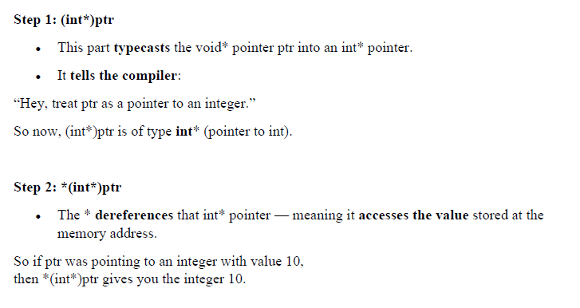

Slide 24
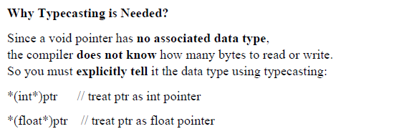

Slide 25
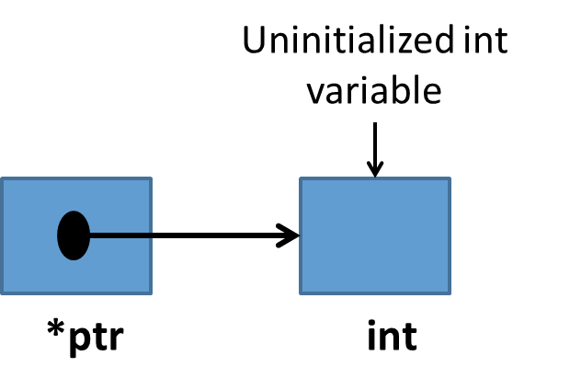
new and delete keywords
New is used to allocate memory dynamically
      int*p; // declares an int pointer
      p =new int; // dynamically allocate memory using new
      *p = 10 // assign value to allocated memory
delete is used to release the allocated memory
      delete p;
      delete[] name;
      delete str;

Slide 26
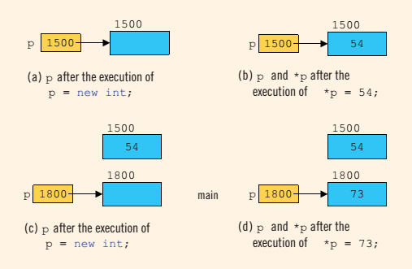
new keyword

Slide 27
Colloc
“calloc” or “contiguous allocation” method in C is used to dynamically allocate the specified number of blocks of memory of the specified type. It is very much similar to malloc() but has two different points and these are:
It initializes each block with a default value ‘0’.
It has two parameters or arguments as compare to malloc().
Syntax:
ptr = (cast-type*)calloc(n, element-size);
here, n is the no. of elements and element-size is the size of each element.

Slide 28
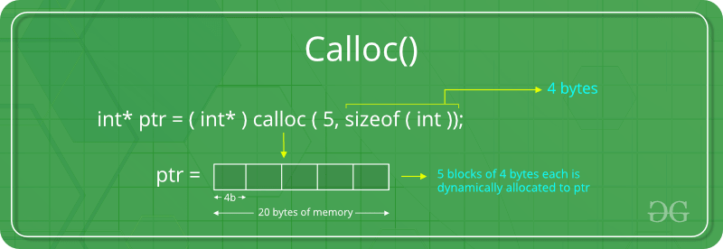
Colloc

Slide 29
Allocating memory dynamically
Calloc function
  Arguments
    Number of elements
    Size of each element
  Example
    calloc( 10, 4) ; // 10 ints x 4 bytes each
    calloc( 10, sizeof ( int ) ) ;
    (int*) calloc ( 1000 , sizeof ( int ) ) ;
Is required memory always available ?
Check if memory is allocated or not.
Notes:
Malloc() function will create a single block of memory of size specified by the user. Calloc() function can assign multiple blocks of memory for a variable. Malloc function contains garbage value. The memory block allocated by a calloc function is always initialized to zero.

Slide 30
malloc ()
The “malloc” or “memory allocation” method in C is used to dynamically allocate a single large block of memory with the specified size.
It returns a pointer of type void which can be cast into a pointer of any form.
It doesn’t initialize memory at execution time so that it has initialized each block with the default garbage value initially.
Syntax:
ptr = (cast-type*) malloc(byte-size)
For Example:

Slide 31
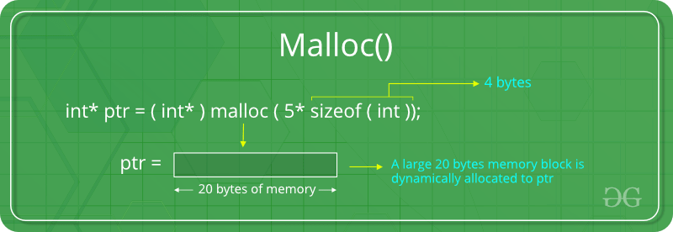
malloc ()

Slide 32
Increase the allocated memory (realloc)
“realloc” or “re-allocation” method in C is used to dynamically change the memory allocation of a previously allocated memory.
In other words, if the memory previously allocated with the help of malloc or calloc is insufficient, realloc can be used to dynamically re-allocate memory.
re-allocation of memory maintains the already present value and new blocks will be initialized with the default garbage value.
Syntax:
ptr = realloc(ptr, newSize);
where ptr is reallocated with new size 'newSize'.

Slide 33
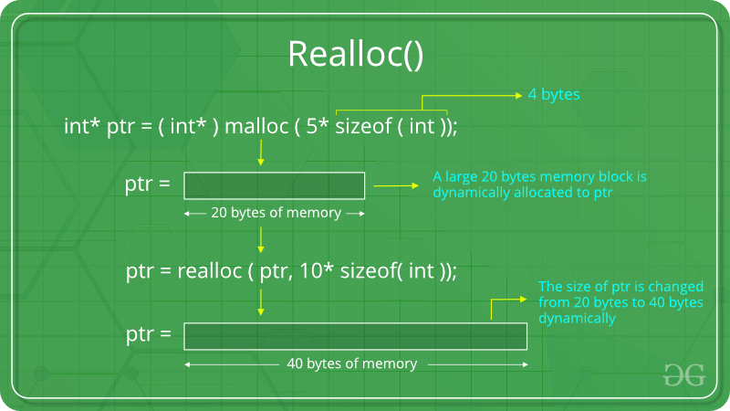

Slide 34
Problems with DMA
Memory leak
  Memory allocated but not released properly
Dangling Pointers
  Pointer pointing to illegal memory

Slide 35
Points to ponder
Using dynamic memory is more efficient than the static memory.
Immediately after a memory allocation call, check whether the memory has allocated successfully.
Whenever possible free the allocated memory in the same function.
Be careful about memory management to prevent memory leakage and dangling pointers.
Before exiting the program, make sure that the allocated memory has freed.

